Slide 1
Human Immunodeficiency Virus (HIV)
Dirk Douwes-Schultz
Larry Dong

Slide 2
Summary of the virus
https://www.ted.com/talks/janet_iwasa_why_it_s_so_hard_to_cure_hiv_aids?language=en (4min30)
Notes:
Embedded in genome

Slide 3
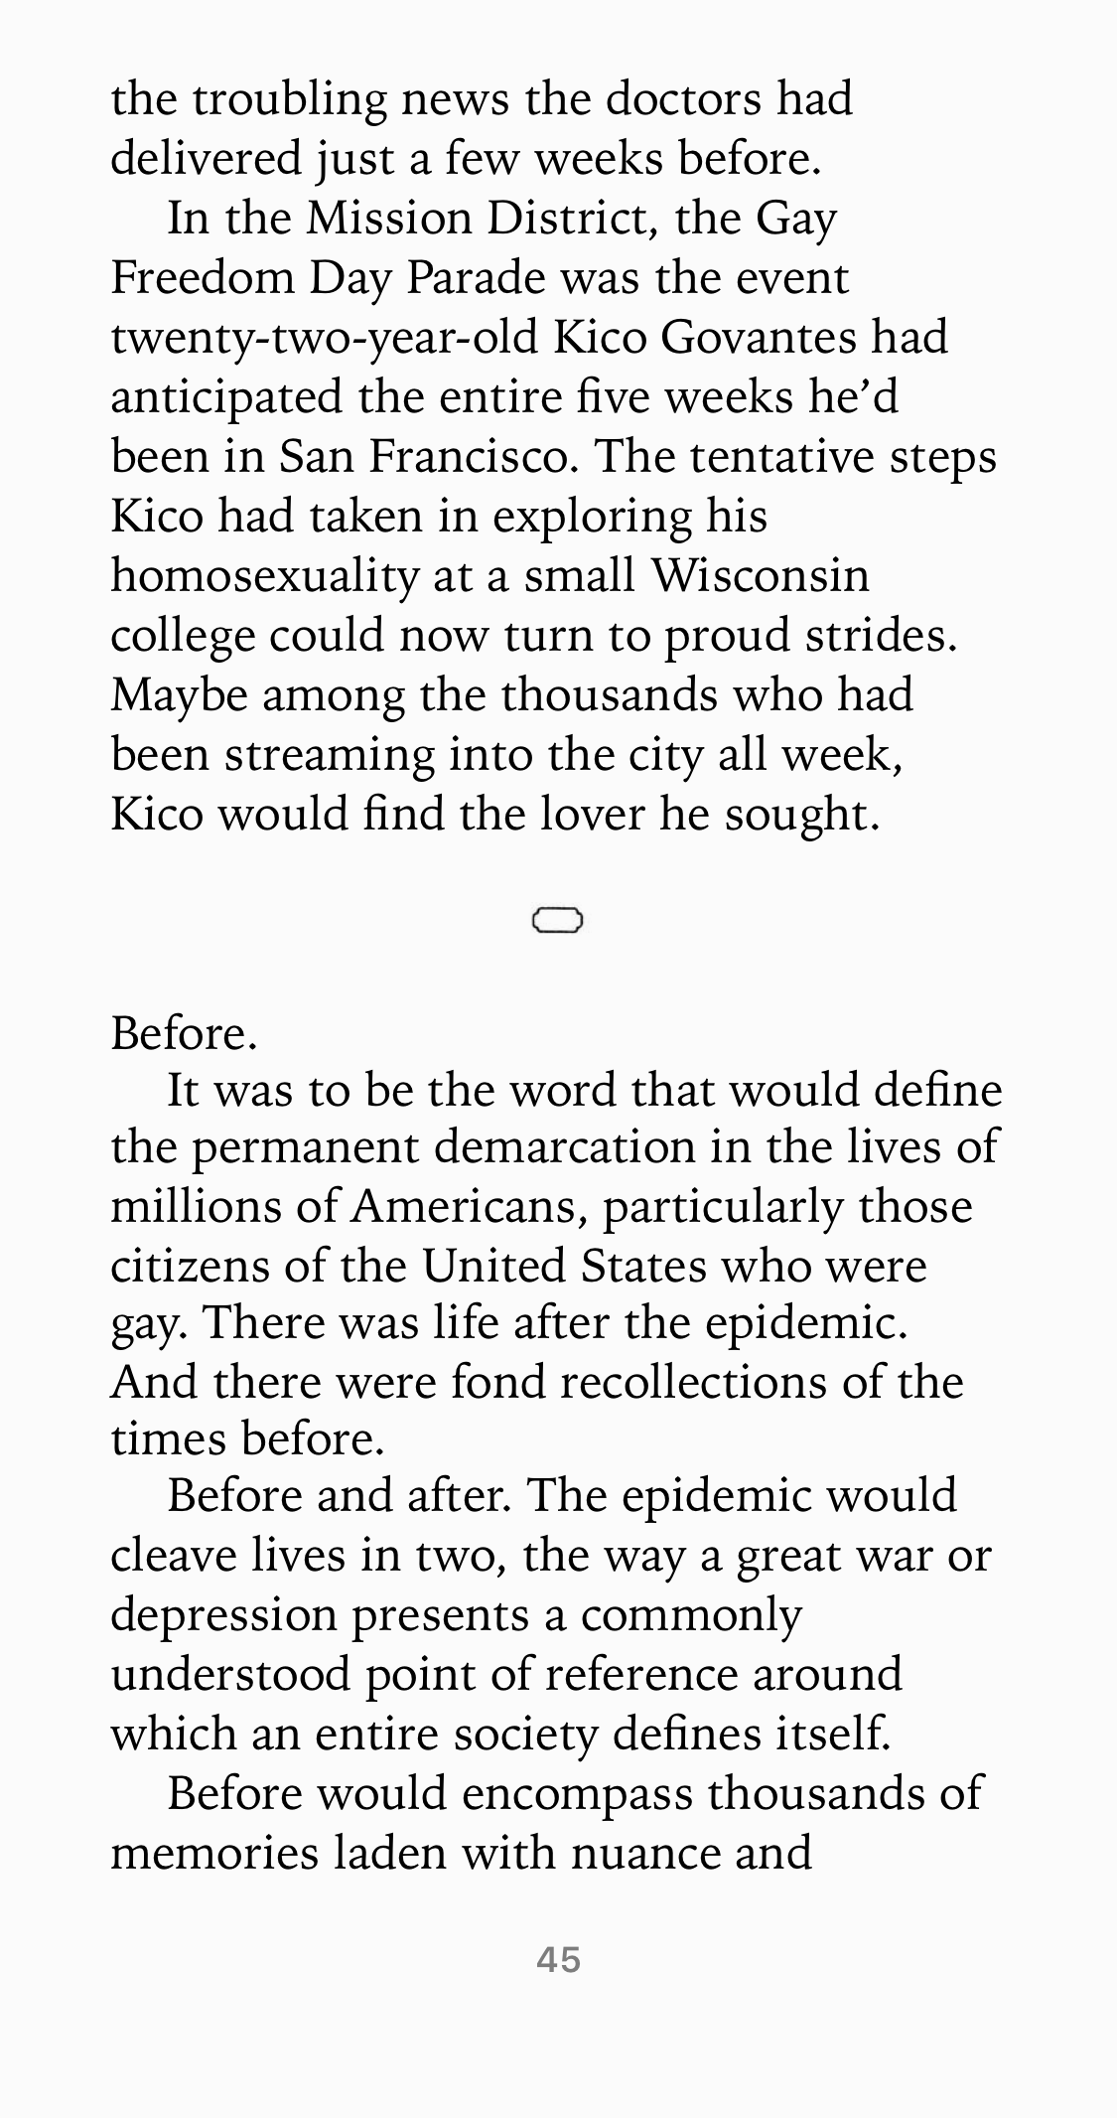
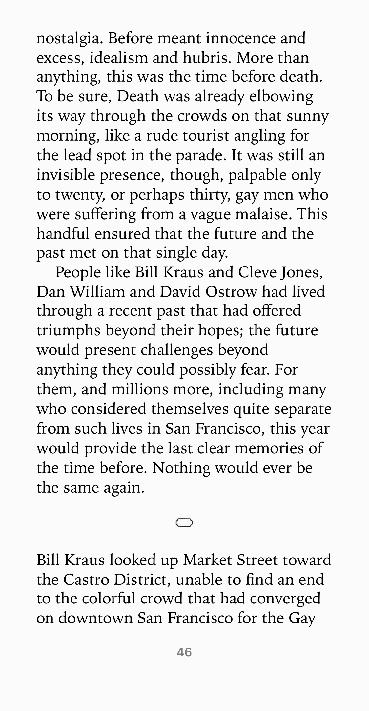
Summer 1980, Before
And the Band Played On
Randy Shilts
Notes:
First openly gay reporter, died of AIDS in 1994.

Slide 4
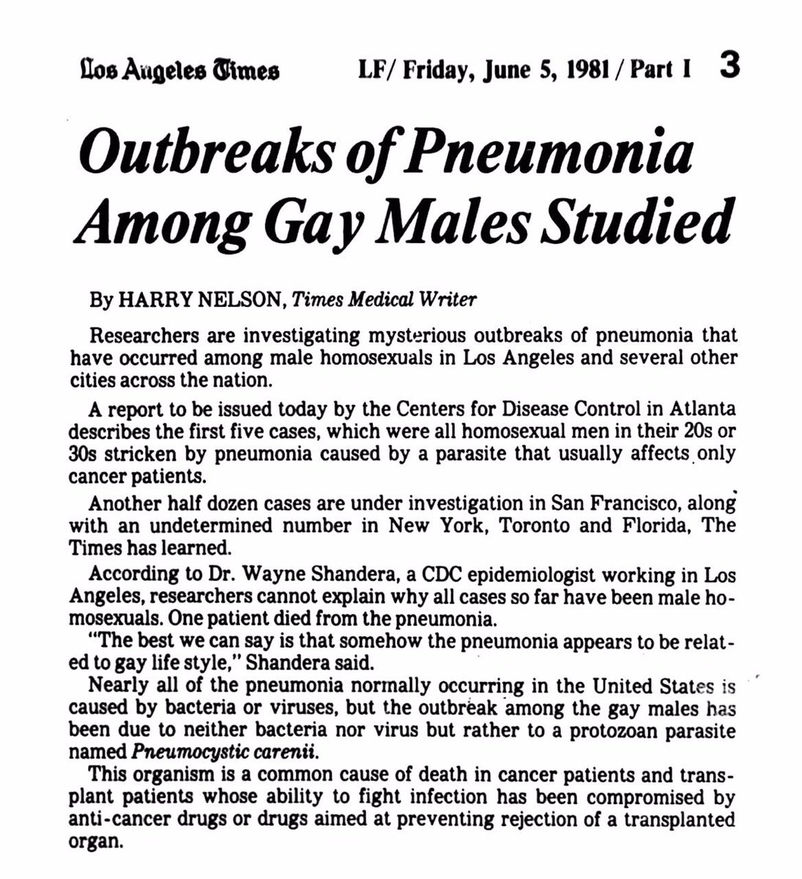
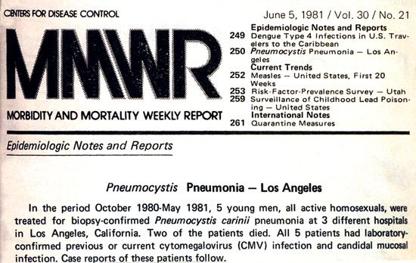
Summer 1981
CDC MMWR June 5, 1981. First 5 AIDS cases reported to the CDC. By the time the article was written there was already many other cases emerging from across the United States.
Notes:
5 young men all active homosexuals treated for a rare form of pneumonia that typically only affects individuals with a very compromised immune system like cancer patients. Speculated it was part of the Gay lifestyle.
https://www.pbs.org/video/frontline-age-aids-part-i/ 3:45-9:37

Slide 5
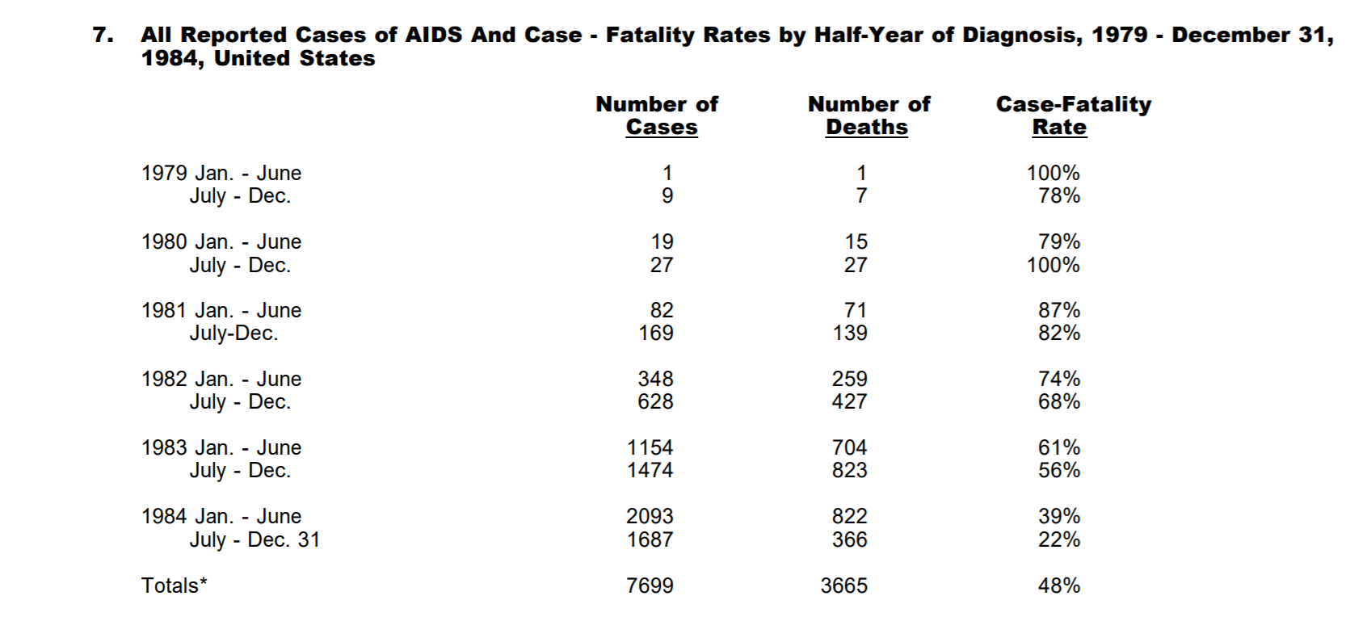
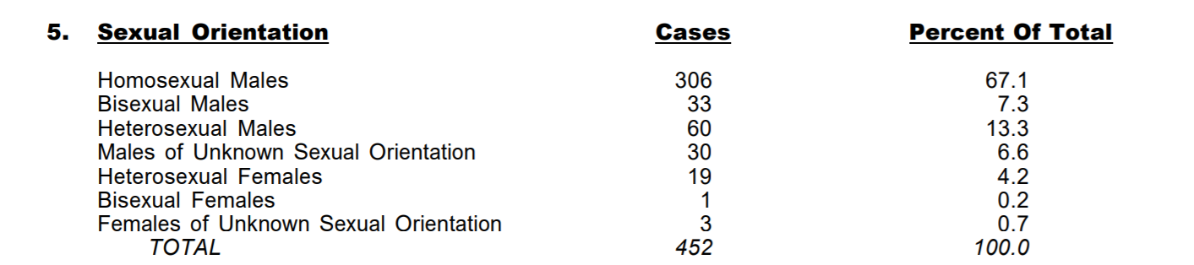
1982-1984 Cases Reported to CDC
Within a year 452 more cases would be reported to the CDC with 177 deaths.
By the end of 1983 this would jump to 3064 cases and 1292 deaths and by the end of 1984 there would be 7699 cases and 3665 deaths. The number of deaths increased quite rapidly after this point.
Notes:
1982 report not all homosexuals

Slide 6
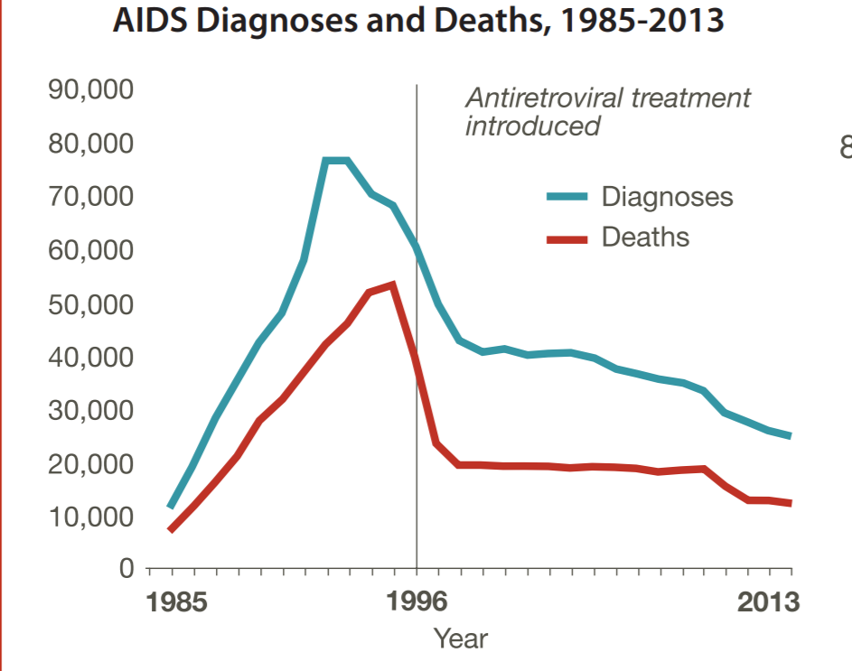
After 1984
675,000 people would die of AIDS in the United States up to 2013, according to the CDC.

Slide 7
1980’s - The beginning of the epidemic
Why the huge jump in cases?
HIV associated with homosexuality
  Strong social stigma
  AIDS killing all the right people
  AIDS entered the blood supply
    Donors were often of low socio-economic status and hence more likely to sell plasma or blood
Public health disaster
16:45 - 23:00, https://youtu.be/fS0OoreV-S4?t=1006
Notes:
Social desirability bias. HIV later discovered to be latent

Slide 8
1980’s - Politics of AIDS
Came at a “wrong time”
  Recently won freedom of sexual expression in homosexual community
    Gay community was still a novel concept
  “Sexual freedom came when sexually transmittable deadly disease was introduced.”
  Bathhouse
    Virus breeding ground
    Bathhouse were being closed by government, but reopened right after by local judge.
    Impact on other more conservative communities?
    “These gay establishments are not fostering gay liberation, they are fostering death and disease.”
    Most political disease

Slide 9
1980’s - Politics of AIDS
Slowly, we started to understand the disease
  Not just for homosexuals
  Non-transmittable by contact
  Often asymptomatic

Slide 10
1984 - Fear
Did politicians tackle this issue?
  How long did it take them to recognize the amplitude of the disease?
  How did they deal with it?
Stigma still present
51:40 - 1:06:45, https://youtu.be/fS0OoreV-S4?t=3100

Slide 11
Late 80’s to Early 90’s- Fight for cure and against stigma
Public health campaigns
Abstinence vs. condoms
Princess Diana:
https://www.youtube.com/watch?v=XU0SPrCTwsY
1:42:00 - 1:47:00
https://www.youtube.com/watch?v=fS0OoreV-S4

Slide 12
HIV Survival Before Effective Treatment
Time from HIV-1 seroconversion to AIDS and death before widespread use of highly-active antiretroviral therapy: a collaborative re-analysis
Collaborative Group on AIDS Incubation and HIV Survival
13 030 HIV-1-infected individuals with known dates of seroconversion from 15 countries.
Median Survival from seroconversion varied from 12.5 years (95% CI 12.1-12.9) for those aged 15-24 years at seroconversion to 7.9 years (7.4-8.5) for those aged 45-54 years at seroconversion.
Notes:
Lancet, hard to know when someone gets HIV.

Slide 13
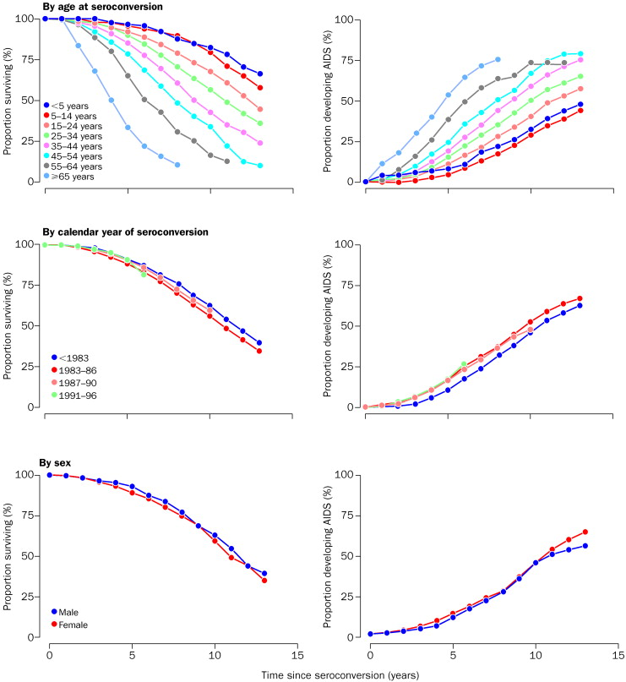
Time from HIV-1 seroconversion to AIDS and death before widespread use of highly-active antiretroviral therapy: a collaborative re-analysis
Collaborative Group on AIDS Incubation and HIV Survival
Notes:
Survival curves fit by Poisson regression, so assumed rate was constant in every year for each group.

Slide 14
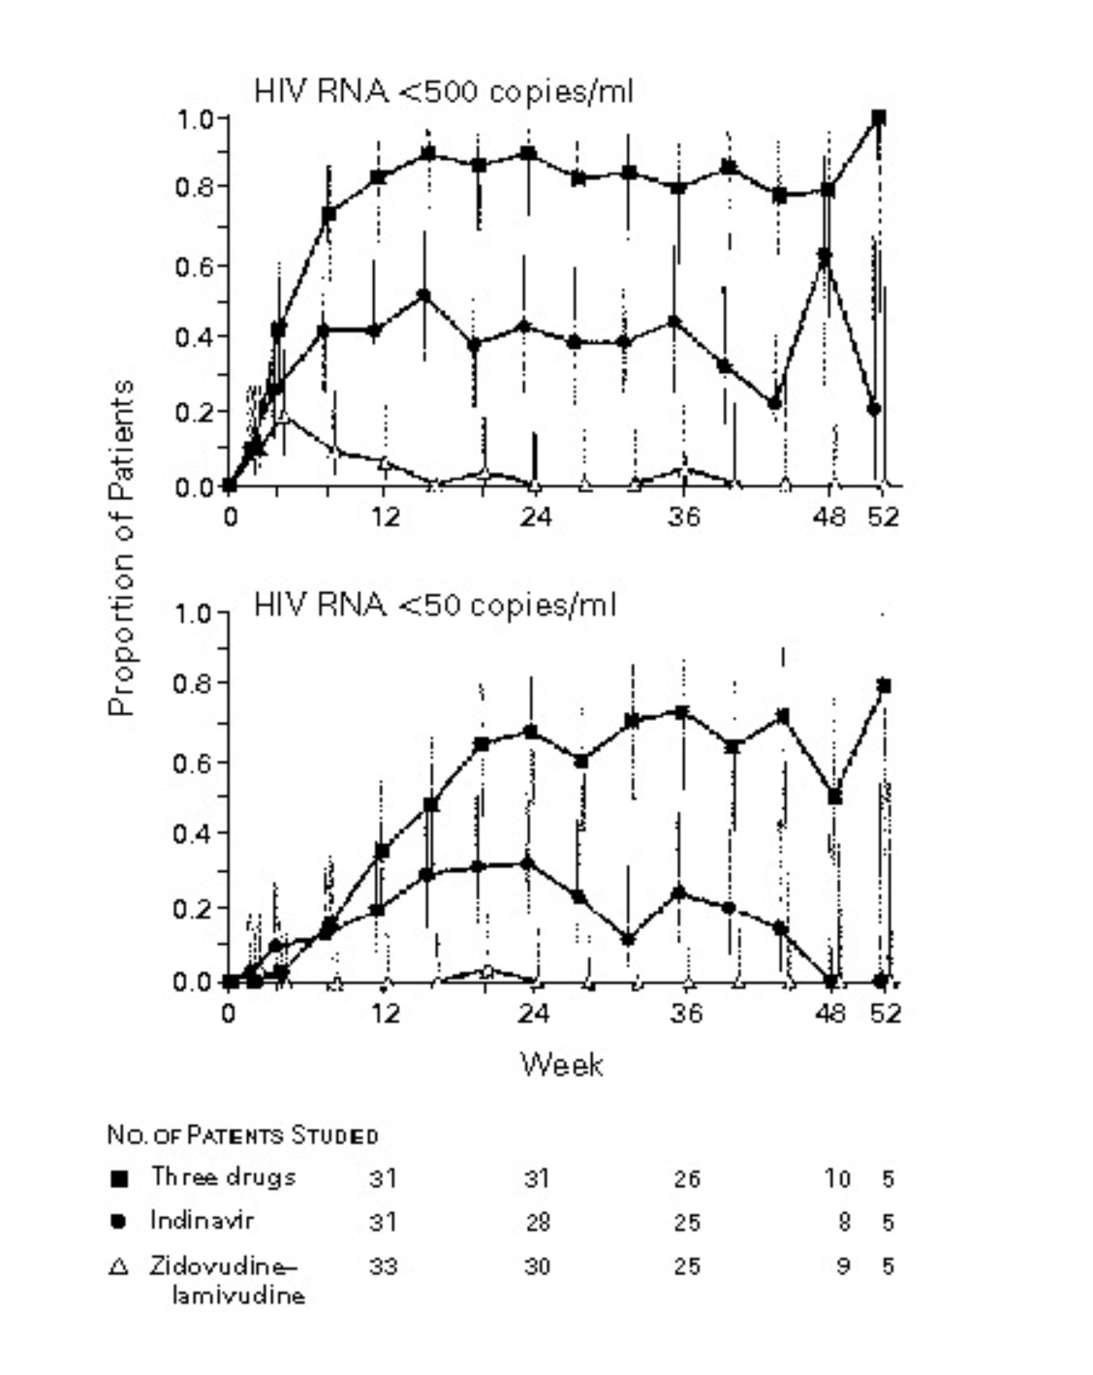
1996 Antiretroviral Therapy
Early attempts at treating HIV, such as AZT, failed.
It was not until 1996 that an effective treatment was found. Idea was to use several drugs and not just one.
Expensive at first with many side effects but became better with time.
NEJM 1997
Notes:
2:14-2:20 in documentary, study is This was a randomized, double-blind, controlled study Treatment with Indinavir, Zidovudine, and Lamivudine in Adults with Human Immunodeficiency Virus Infection and Prior Antiretroviral Therapy, NEJM 1997

Slide 15
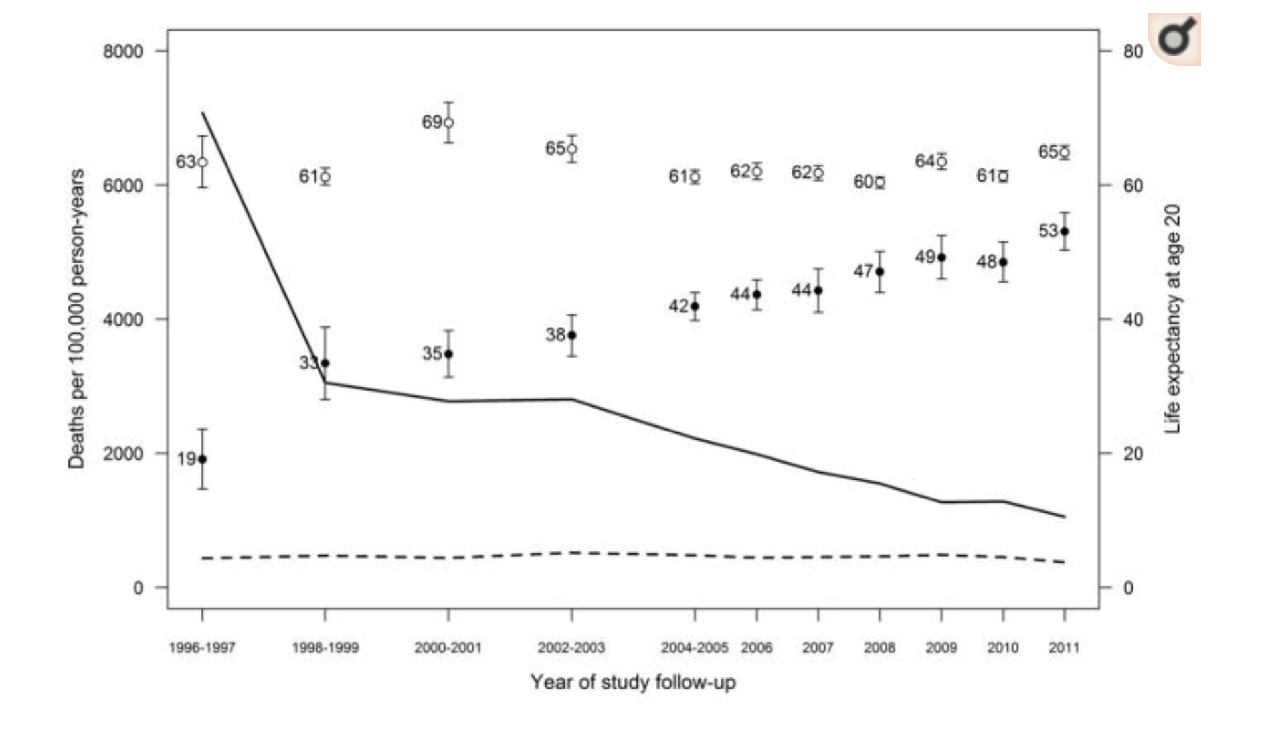
How Effective has ART been?
Turned HIV from a death sentence to a livable condition.
Kaiser Permanente study matched HIV+ individuals with HIV- individuals with similar characteristics.
Smallest gap found was 5.3 years.
Notes:
Narrowing the Gap in Life Expectancy Between HIV-Infected and HIV-Uninfected Individuals With Access to Care. J Acquir Immune Defic Syndr. Smallest gap among individuals who did not smoke and were healthy when they started art and started at a very high cd4 count.

Slide 16
AIDS in Africa
Most people living with HIV are in Africa and most deaths have been in Africa.
https://data.worldbank.org/indicator/SP.DYN.LE00.IN
http://aidsinfo.unaids.org/
Notes:
Just go to the website and show it's the easiest way. Show life expectancy and other things

